Slide 1

Insights of TB detection
CNN, VIT, X-AI

Slide 2
Paper #1 Detection of tuberculosis from chest X-ray images: Boosting the performance with vision transformer and transfer learning

Slide 3
Detection of tuberculosis from chest X-ray images: Boosting the performance with vision transformer and transfer learning
Publish Year : 2021
Cited By : 112
Dataset Distribution : Train=80%, Valid=10%, Test=10%
ViT Used : ViT_Base_EfficientNet_B1_224
Image resolution : 224 X 224 pixels

Slide 4
Detection of tuberculosis from chest X-ray images: Boosting the performance with vision transformer and transfer learning
Accuracy : 97.72%
AUC (Area under curve) : 100%
Reference:
https://www.sciencedirect.com/science/article/abs/pii/S0957417421009295?casa_token=pA1R7wpHGV4AAAAA:rnY6Sf8EMELyuHK6Ob1u6f8G80xjmhuNaEyi6MMqinfmroq88BP1NBBlVnNnpAEdcWsDtMc6xkk

Slide 5

Paper#2 Detecting Tuberculosis-Consistent Findings in Lateral Chest X-Rays Using an Ensemble of CNNs and Vision Transformers

Slide 6
Detecting Tuberculosis-Consistent Findings in Lateral Chest X-Rays Using an Ensemble of CNNs and Vision Transformers
Publish Year : 2022
Cited By : 19
Dataset Distribution :
CheXpert CXR dataset : 23,633 Abnormal CXR, 4,717 Normal CXR
90% test data, 10% train
2. PadChest CXR dataset : 33,454 Abnormal CXR, 14,229 Normal CXR
Image Resolution : 224 × 224

Slide 7
Detecting Tuberculosis-Consistent Findings in Lateral Chest X-Rays Using an Ensemble of CNNs and Vision Transformers
Models Used for Classification :
VGG-16
DenseNet-121
EfficientNet-V2-B0
ViT-Base (B)/16
ViT-B/32
ViT-Large (L)/16
ViT-L/32
Reference:
https://www.frontiersin.org/journals/genetics/articles/10.3389/fgene.2022.864724/full

Slide 8
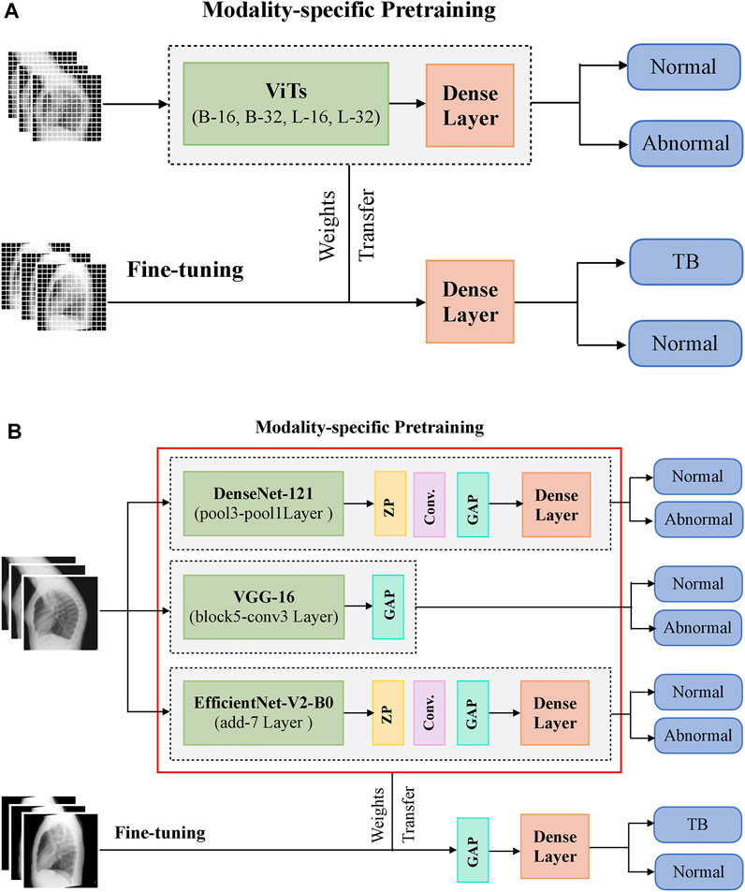
Detecting Tuberculosis-Consistent Findings in Lateral Chest X-Rays Using an Ensemble of CNNs and Vision Transformers

Slide 9
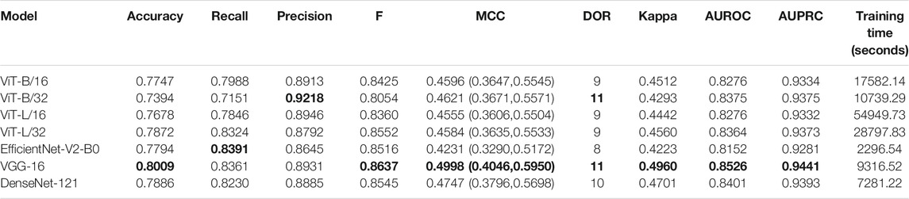
Detecting Tuberculosis-Consistent Findings in Lateral Chest X-Rays Using an Ensemble of CNNs and Vision Transformers
The CNN models took comparatively lesser time to converge than the ViT models.
CLS score 95%

Slide 10
Paper#3 ViT-TB: Ensemble Learning Based ViT Model for Tuberculosis Recognition

Slide 11
ViT-TB: Ensemble Learning Based ViT Model for Tuberculosis Recognition
Publish Year : 2024
Cited By : 11
Dataset Distribution : Shenzhen and Montgomery datasets
Methodology Used : ViT and EfficientNet
Reference:
https://www.tandfonline.com/doi/abs/10.1080/01969722.2022.2162736?casa_token=U22tsmSQNaQAAAAA:OMyFOC56M6uNiaBjuXaJlxRgd2wAEnqi38wiu9eAIg07-UE26uiQFunRWsJO63-6OeGISL_CJhyrepU
Note. The methodology and result aspects are missing here due to Premium Article Access.

Slide 12
Paper#4 Explanatory classification of CXR images into COVID-19, Pneumonia and Tuberculosis using deep learning and XAI

Slide 13
Explanatory classification of CXR images into COVID-19, Pneumonia and Tuberculosis using deep learning and XAI
Publish Year : 2022
Cited By : 68
Dataset Distribution : The dataset is taken from the following three different papers
1. [44] Large dataset of labeled optical coherence tomography (OCT) and chest X-Ray images.
2. [45] Reliable tuberculosis detection using chest X-Ray with deep learning, segmentation and visualization
3. [46] Chest X-ray (Covid-19 and pneumonia)

Slide 14
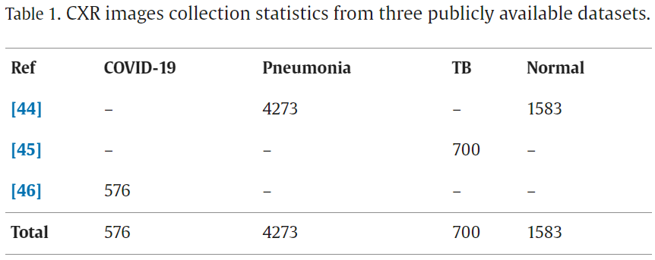
Explanatory classification of CXR images into COVID-19, Pneumonia and Tuberculosis using deep learning and XAI

Slide 15
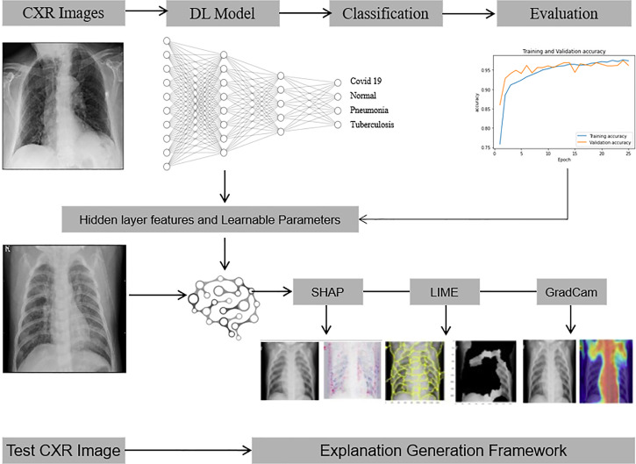
Explanatory classification of CXR images into COVID-19, Pneumonia and Tuberculosis using deep learning and XAI
Results are interpreted through:
LIME
GRAD CAM
Shapley
Accuracy : 94.31%
Reference:
https://www.sciencedirect.com/science/article/pii/S0010482522008642?casa_token=IE3D8ttPl3IAAAAA:TFgBmsaIxeAwP-pP4mO-deHSHx7NqqeYANGtrwXUMD8zRQ3tN0-nKbo3jqI-XXKKg9DDhkIsonQ#b46

